Slide 1

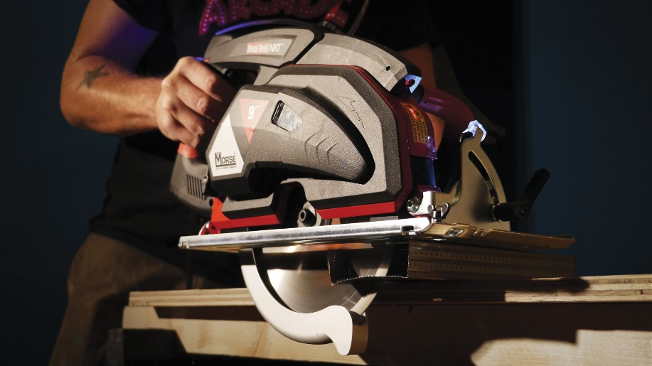

Metal Devil Circular Saws
Notes:
Welcome to the training for the Morse Metal Devil Circular Saws.
We will be taking the next 10-15 minutes to review basic information about these tools.

Slide 2
Training Highlights
What is a Metal Devil Saw
Morse Metal Devil Saw Overview
Applications
Selling tools
Notes:
We’ll start by identifying what Metal Devil circular saws do well. We’ll then introduce the line of Morse Metal Devil saws and discuss how they are different from wood cutting saws. And then provide tips to help users get the most out of their tools. We’ll finish with tools to help you close the sale.

Slide 3

Metal Cutting History
Abrasive Wheels
as the wheel cuts the material, the tiny, sharp abrasive particles are worn off
Notes:
Traditionally, abrasive wheels have been used for cutting metal with portable machines. There are many downsides to this abrasive wheels:
They cut relatively slowly
They leaves large burrs on the workpiece.
They throw sparks that are created during the cut. These sparks are not only an annoyance, they can also be a fire hazard in some situations.
As the wheels wear, they become smaller in diameter and this reduces the depth of cut that can be achieved.

Slide 4
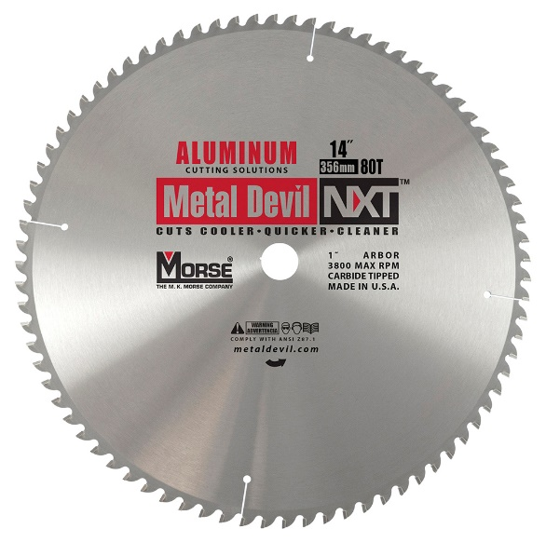
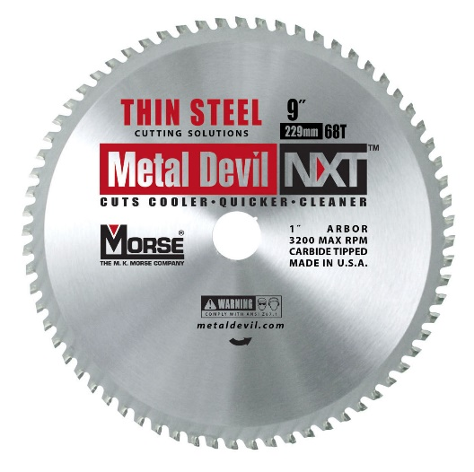
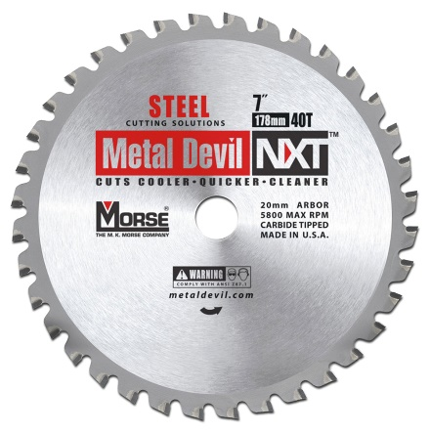
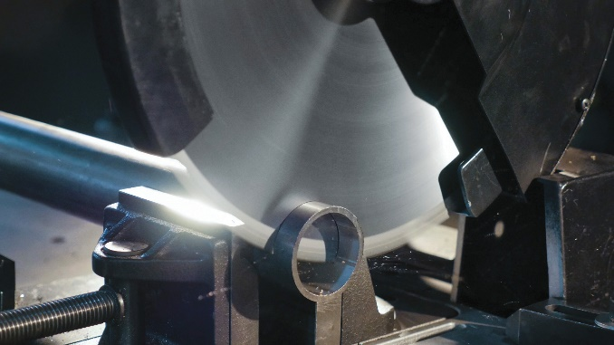
Metal Devil Circular Saws
Cutting metal is more efficient when using Metal Devil circular saws.
Morse Metal Devil circular saws
  Cut cool
  Cut faster
  Cut longer
Notes:
Cutting metal is more efficient when using Metal Devil circular saws.
These blades combine metallurgy and unique tooth configurations tailored for peak performance in specific applications.
Morse Metal Devil circular saws:
They cut cool: The specialized metallurgy of the carbide tips means minimal heat is transferred to the inner plate, so the freshly cut metal edges are cool to the touch
They cut faster: 12 seconds to go through 6” x ¼” thick steel
They cut longer: Tungsten carbide and titanium carbide tips brazed to the teeth of a hardened steel plate offer exceptional wear resistance and more cuts over the life of the blade.

Slide 5
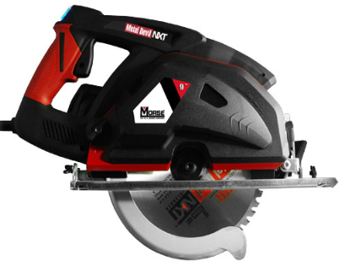
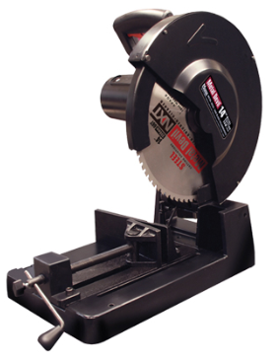
Metal devil circular saws & blades
When to Use Metal Cutting Circular Saws
Use with tipped blades, not grit blades
Cut a wide range of materials
Straight or angle cuts
Leave a clean, weldable finish
Optimized for low RPM metal cutting
Blade diameter determines the maximum cut depth
Notes:
Use a Metal Devil saw for cutting a wide range of materials from aluminum, to mild steels and even stainless steel. They can make straight or angled cuts that are clean and weldable with no secondary finishing required.
These saws are much different than wood cutting circular saws.
They run at a lower RPM than wood cutting circular saws. This lower speed is optimum for the mechanics of metal cutting.
These metal cutting tools also have guarding and chip containment features that prevent the hot metal chips from burning the user.

Slide 6
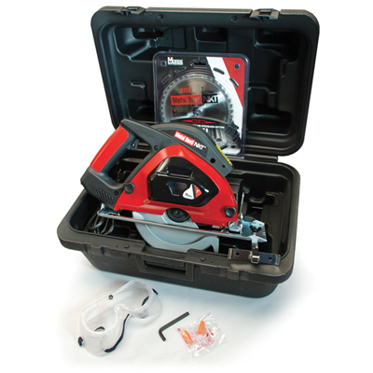
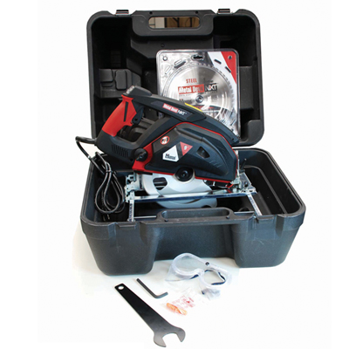
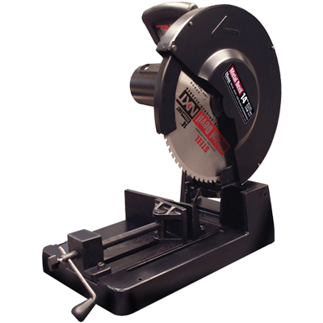
Morse metal Devil saws
Morse offers 3 metal-cutting saws:
7” Sidewinder
9” Worm Gear
14” Chop Saw
Notes:
Morse offers 3 metal-cutting saws:

Slide 7
Morse metal Devil saws
Morse offers 3 metal-cutting saws:
7” Sidewinder
9” Worm Gear
14” Chop Saw
Notes:
The 7” Side-Wind saw works with 7-inch or 7-1/4 in. blades. This saw is preferred by construction trades because of its versatility and light weight portability. It has a 2-3/8” maximum cutting reach and ¼” maximum material thickness.

Slide 8
Morse metal Devil saws
Morse offers 3 metal-cutting saws:
7” Sidewinder
9” Worm Gear
14” Chop Saw
Notes:
The 9” Worm Gear saw has a 3-1/4” maximum cutting reach. This saw is best for fabricators and shops who need a heavy-duty saw to cut steel plate and larger structural shapes. It cuts a 3/8” maximum material thickness.

Slide 9
Morse metal Devil saws
Morse offers 3 metal-cutting saws:
7” Sidewinder
9” Worm Gear
14” Chop Saw
Notes:
The 14” Chop Saw is a powerful and versatile saw that is used everywhere from construction sites to shops.
For 90-degree cutting, it can cut up to 5 1/8 inch diameter rounds and 4 ¾ by 4 ¾-inch squares. It can cut rectangular parts that are 3 ¾ by 7 ¼ inches.
When set for a 45-degree cut, it can cut up to 4 1/8 inch diameter rounds and 3 ½ by 3 ½ inch squares. It can cut rectangular parts that are 3 1/8 by 3 1/8 inches in size.

Slide 10

Machine Basics
Be sure the machine is within the RPM limitations of the blade to be used
Set the cutting depth as deep as possible for hand-held machines.
For chop saws, use V-Blocks whenever possible
To improve blade life let the blade cool between cuts/passes
All the heat of the cut is in the chips, so be sure to clean the chip-catcher regularly
Notes:
There are some basic guidelines that should be followed when using a Metal Devil saw.
Be sure the machine is within the RPM limitations of the blade to be used.
Set the cutting depth as deep as possible for hand-held machines. This will maximize the performance of the blades because it minimizes the area being cut by each tooth. One exception to this rule is when cutting metal grating, set the blade depth so that it is just slightly deeper than the thickness of the grating.
For chop saws, use V-Blocks whenever possible, especially when cutting square pipe / tube and plate.
To improve blade life let the blade cool between cuts/passes. It is recommended to let the blade and machine cool for 30 minutes for every 30 minutes of use.
Be sure to clean the chip-catcher regularly.

Slide 11
Sales Tools
Digital
Morse Web Site
http://mkmorse.com
Videos
Morse YouTube Channel
https://www.youtube.com/user/TheMKMorseCompany/videos
Notes:
Additional information on Metal Devil circular saws is available on the company web site and YouTube channel.

Slide 12

Metal Devil Circular Saws
330-453-8187
Notes:
Thank you very much for your time today.
If you have any questions or would like further information, please give us a call at 330-453-8187.

