Slide 1

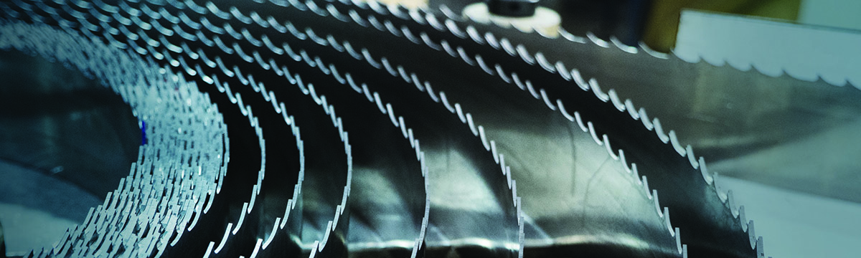
Band Saw Blade Basics
Notes:
Welcome to Band Saw Blade Basics Training from the M. K. Morse Company. This program is designed to arm you with general information about band saw blades.

Slide 2
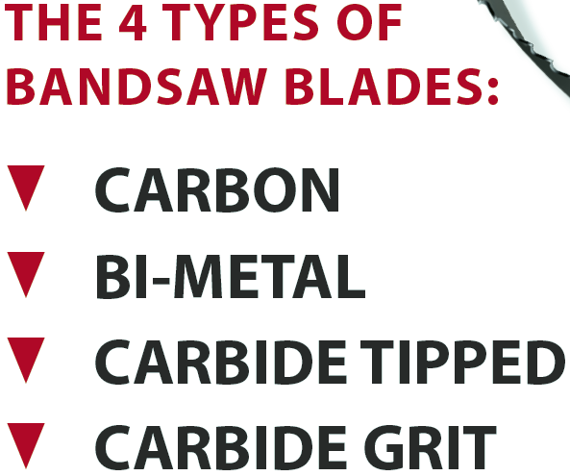
Notes:
M. K. Morse Band Training Class May, 2013
Today there are four main types of blades used in the band saw industry. We will look at the four separately to explain their features and benefits.

Slide 3
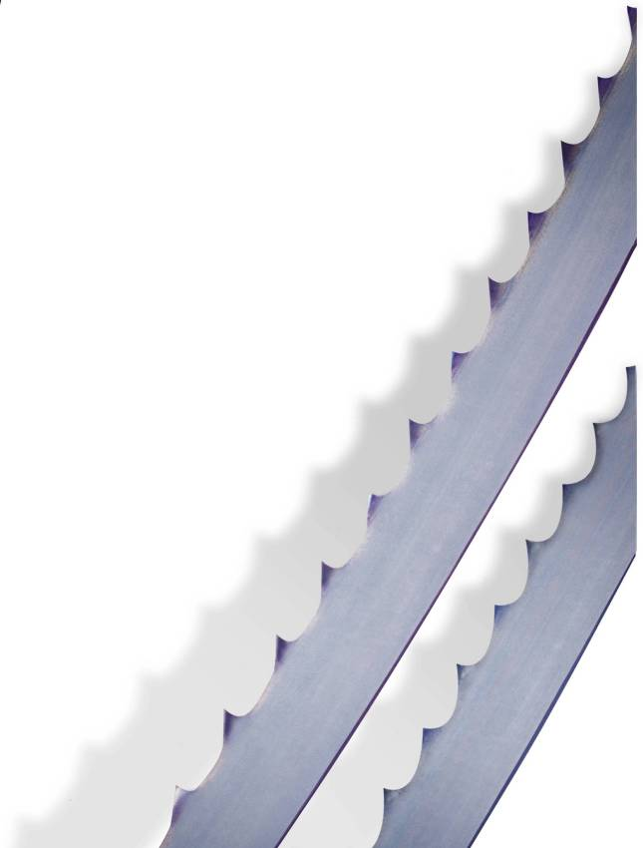

Carbon Blades
One piece carbon steel construction
2 Types
  HEF
  HB
Economically priced
Notes:
M. K. Morse Band Training Class May, 2013
Carbon blades are made of one single grade of carbon steel.
There are two basic types of carbon blades; Flex Back (HEF) and Hard Back (HB)
Because carbon blades are easier to make and the raw materials are less expensive, carbon blades are the lowest cost of the four types of blades. This does not mean they are an inferior product. For some applications, they continue to provide the best value for the money.
Carbon blades do have limitations. For example, they cannot be used to cut stainless steel.

Slide 4
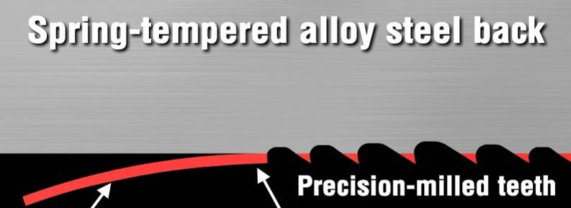
Bi-Metal Construction
Electron-Beam or Laser Welding Fuses Flexible Back and High Speed Edge
Precision Milled Teeth
Super Hard High-Speed Steel Cutting Edge
Notes:
Bimetal blades are made from two different grades of steel. A narrow wire of High Speed Steel is welded to the spring tempered alloy steel blade body by either Electron Beam or Laser welding.
The High Speed Steel wire is used to form the cutting edge of the finished blade. When heat treated, this edge will become extremely hard and wear resistant. This enables the blade to cut difficult-to-machine materials.
Different grades of HSS are used depending on the targeted application of each type of bimetal blade. These will be discussed later in the presentation.

Slide 5
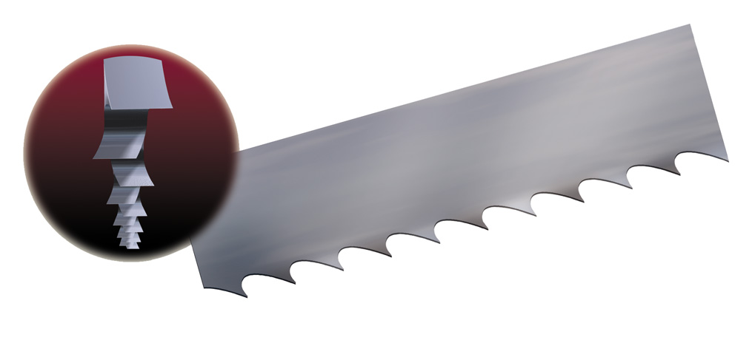
Anatomy of a Saw Blade
3
2
. . .
4
1
14
9
12
10
13
---------
…
11
5
6
8
7
Blade Backer
Thickness
Width
Set
Tooth
Tooth Pitch
T.P.I.
Gullet
Gullet Depth
Tooth Face
Tooth Flank
Tooth Rake Angle
Tooth Tip
Kerf
Notes:
This illustration shows the terminology associated with a typical band saw blade. This terminology will be used throughout this presentation.

Slide 6
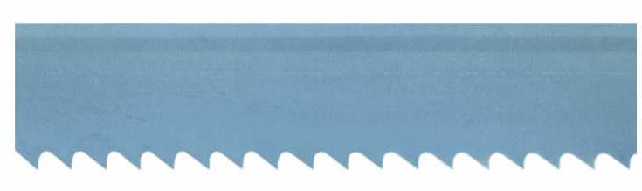
Tooth Forms – Zero Rake
Tooth face is perpendicular to the back edge
Less aggressive than Positive Rake
Best for interrupted cutting applications
Zero Degree Rake
Notes:
On zero rake blades, the tooth face is perpendicular to the back edge. This style of blade is best for interrupted cutting.

Slide 7

Tooth Forms – Positive Rake
Tooth face is angled forward, towards the direction of cutting
Available in both constant pitch tooth forms and variable pitch tooth forms
Various positive degrees depending on tooth size and type
More aggressive than Zero Rake
Used for solids and heavy walled structures
Positive Rake
Notes:
The face of the teeth are angled forward, towards the cutting direction, on positive rake tooth forms. These tooth forms are more aggressive than zero degree rake tooth forms, allowing higher cutting speeds. These blades are ideal for cutting solid materials and heavy walled structural shapes.

Slide 8
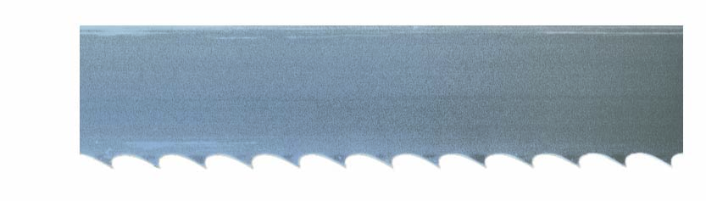
Tooth Forms
Elongated gullet
10° positive rake
Used for wood, aluminum and some metal cutting
Ferrous and non-ferrous
Straight Pitch
Hook
Notes:
Hook style teeth have an elongated gullet and steep rake angle. These blades are well-suited for cutting wood and aluminum. Hook tooth forms are straight pitch which means the distance between every tooth is the same. The distance between each tooth is known as the pitch and the size of the pitch is measured in teeth per inch or TPI.

Slide 9
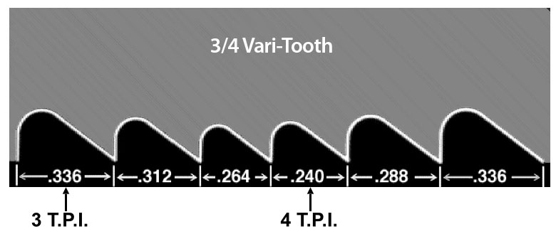
Variable Tooth (Variable Pitch)
Tooth points are constant height
Gullet depth and tooth spacing varies
There is a pattern of teeth that repeats along the blade
Number of teeth in the pattern and pattern length varies depending on tooth size
Tooth size consists of two numbers (e.g. 4/6, 8/12)
Notes:
M. K. Morse Band Training Class May, 2013
Variable Pitch tooth forms have a variable distance between each tooth. When cutting with constant pitch teeth, each tooth vibrates with the same frequency. This vibration (noise) is detrimental to blade life.
Variable pitch tooth forms allow each tooth in the pattern to vibrate at a different frequency. They tend to cancel out, causing the blade to run quieter, with less vibration.
The pattern of teeth in a given variable pitch tooth form consists of two numbers, for example 4/6. Some people think this means it is a pattern consisting of 4 TPI and 6 TPI alternating. This is incorrect. In the tooth pattern, the number of teeth varies with tooth size. For example, the 4/6 pattern consists of 9 teeth. Within this pattern, all the teeth are of different size meaning the gullet depth and distance between tooth points is different for every tooth. The 4/6 designation indicates the largest tooth in the pattern (4 tpi) and the smallest tooth in the pattern (6 tpi). All the other teeth are between the largest and smallest tooth sizes. There is a gradual change from the smallest tooth to the largest tooth then back to the smallest tooth.

Slide 10
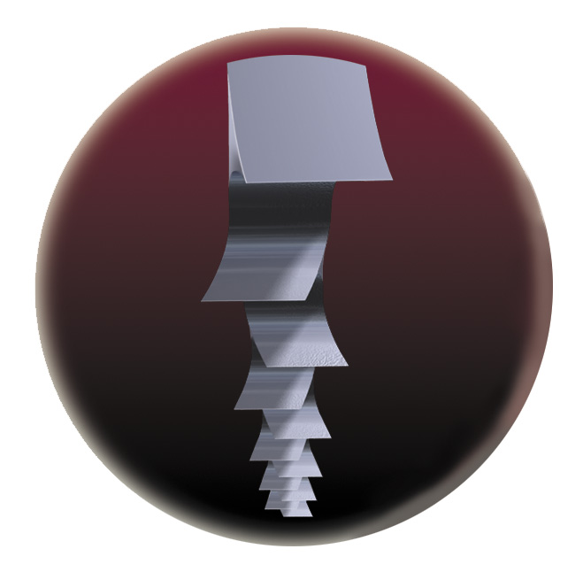
Why is Set Necessary?
Tooth set, the bending of the teeth to the left and right, creates a kerf (the slot being cut by the teeth) to be wider than the thickness of the blade body, creating clearance for the blade body to pass through the cut being made.
Notes:
Tooth set refers to the offset of the teeth to the left and the right side of the blade. If the teeth were not offset, when the blade begins a cut, the kerf or slot being cut would be the same width as the blade body. There would be no clearance on the sides of the blade, and the blade would tend to pinch in the cut.
By offsetting the teeth, the kerf becomes wider than the blade body thus creating clearance for the blade to pass through the cut being made.
Cutting different types of materials requires different amounts of set. For example, cutting contours in wood, or cutting large ingots of steel requires a large amount of set. Cutting smaller bars of steel requires less set. Set magnitude is one of the characteristics of the blade that we fine tune to optimize performance within our blade categories.

Slide 11
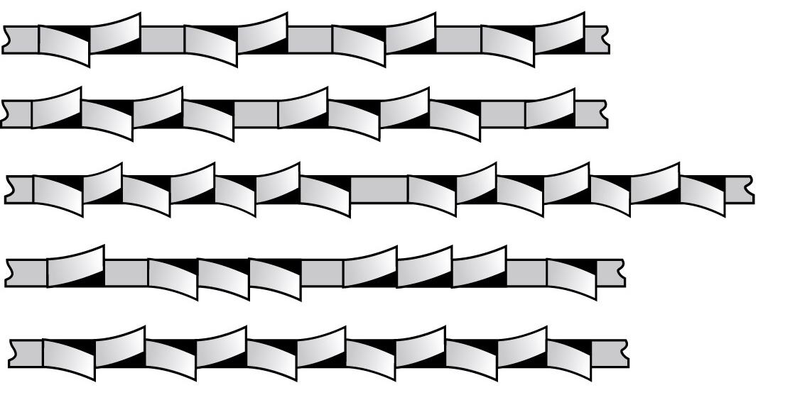
Variable Pitch Modified Raker
Set sequence depends on the number of teeth in the variable pitch tooth pattern.
Recurring sequence with more than two set teeth before an unset tooth.
Notes:
As explained earlier, variable pitch teeth have a given pattern. The number of teeth in each pattern varies depending on the size of the teeth. Within these patterns, the teeth are alternately set left and right with one tooth, usually the largest tooth, left unset.

Slide 12
Bi-Metal Blade Types
Matrix
  Matrix II HSS tooth edge
  Standard body steel
M42
  M42 HSS tooth edge
  Standard body steel
Maverick
  M42 HSS tooth edge
  High strength body steel
Challenger
  M42 HSS tooth edge
  Standard body steel
  Unique tooth geometry designed for cutting structural steel, pipe and tube
Independence II
  Proprietary HSS tooth edge similar to M51 HSS
  High strength body steel
  Positive rake teeth, varying depending on tooth size
Independence EXS
  Same edge and body steel as Independence II
  Positive rake with high rake angles
Notes:
There are 6 different families of bimetal blades. The benefits of each will be explained in later training modules.

Slide 13

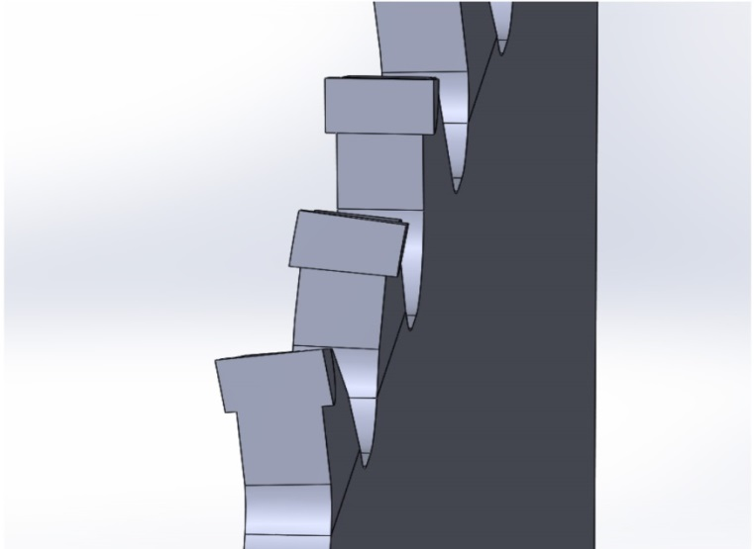
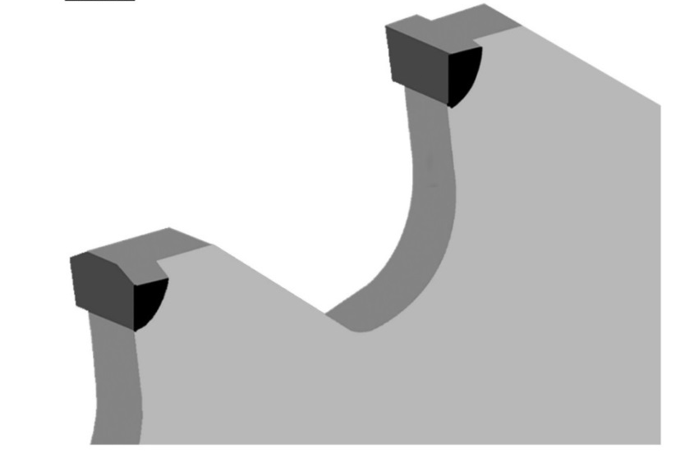
Carbide Tipped Blades
Designed for difficult-to-machine alloys, tool steels, stainless steels, high-temperature alloys and super alloys.
Set Tooth
Triple Chip
Notes:
Our family name for Carbide Tipped (CT) blades is M-Factor.
There are five different types of CT blades, GP, GES, CH, FB+ and FBS. Each will be discussed in later modules.

Slide 14
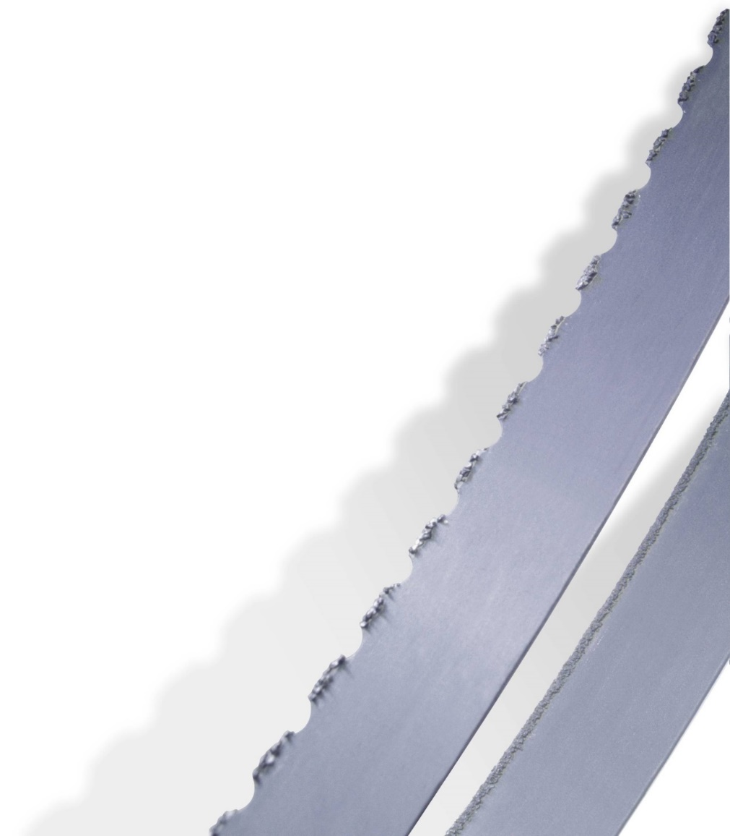
Carbide Grit Edge
Long Life
Superior resistance to heat, wear and abrasion
2 Types
  Gulleted Edge
  Continuous Edge
Notes:
Tungsten Carbide Grit Edge blades are blades that have Tungsten Carbide particles attached to one edge of the strip rather than having pointed teeth.
There are two types; continuous edge having an unbroken line of grit along the entire length of the blade and gulleted edge that has the grit broken up into short lengths with spacing (gullets) between the short lengths.

Slide 15

Band Saw Blade Basics
330-453-8187
Notes:
Thank you for your time today. We sincerely hope this training improved your knowledge of band saw blade basics.
If you have any questions or would like further information, please give us a call at 330-453-8187.

