Slide 1

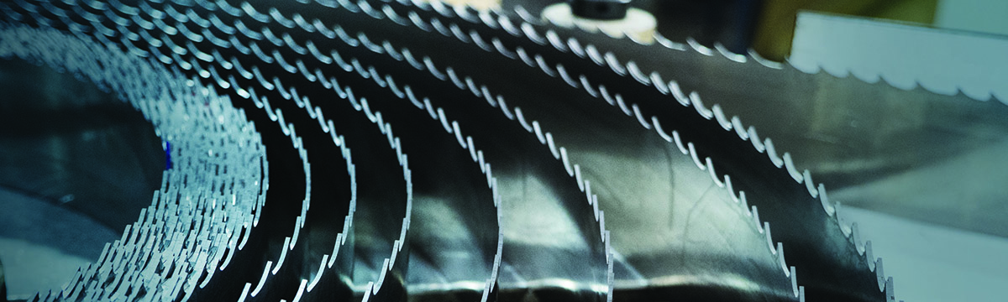

Band Saw Blade Break-in
Notes:
Welcome to Band Saw Break-in Training from the M. K. Morse Company. By the end of this training, you will know how to improve the life of band saw blades by performing a break in procedure.

Slide 2

Blade Break-In
Notes:
What is a blade break-in? Why should we do it? How do we do it? These questions will all be answered in the following slides.

Slide 3
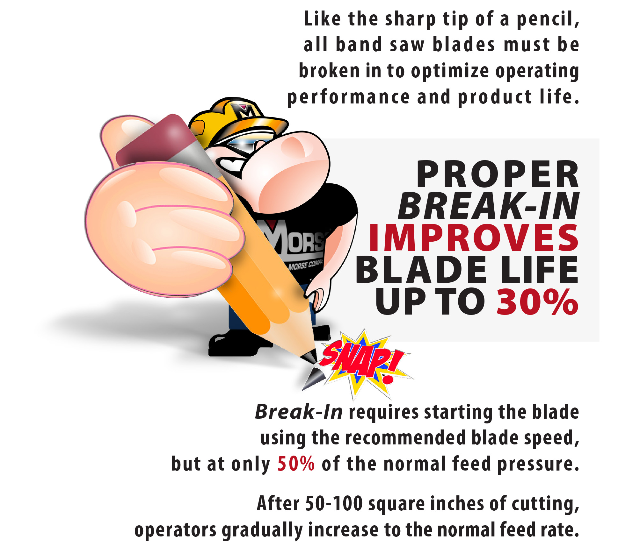

PROPER BREAK-IN IMPROVES BLADE LIFE UP TO 30%
Notes:
The cutting edges on a brand new band saw blade are ultra sharp. Breaking in a new saw blade hones these sharp edges in a controlled manner, producing a cutting edge that is slightly blunt. A good analogy is how the pencil lead of a freshly sharpened pencil has more of a tendency to break than pencil lead that has been used for a while.
Conducting a proper break-in on a new blade can improve the it’s life by up to 30%.

Slide 4
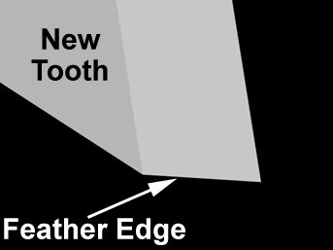
The Sharp Edge
Sharp Edge
Notes:
This illustration shows the sharp cutting edge of a new tooth. Much care is taken throughout the manufacturing process to ensure that the tooth stays sharp. The tooth is protected and is never allowed to touch another hard surface in our plant.
Once the blade is placed on a band saw machine, the first thing it touches is the workpiece. This initial impact of the new tooth can be a shock if it happens at the normal operating feed rate.

Slide 5
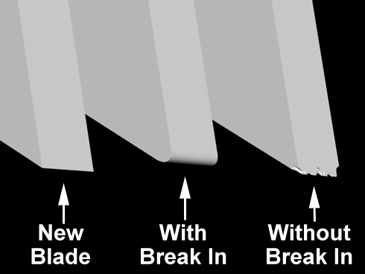
Edge Comparison
Notes:
Under the slower feed rate of a break-in procedure, this initial impact is much lower. After 20 minutes of cutting at the break-in parameters, the tooth is nicely honed and ready to begin cutting at the full recommended feed rate.
Without break-in, the shock of the initial cuts on the new tooth causes microscopic chipping and cracking of the tooth edge that happen in a less predictable manner. These chips and cracks will accelerate the wear of the teeth, ultimately leading to shorter usable life for the blade.

Slide 6
Simple Procedure
Set the recommended blade speed for the material to be cut.
Reduce feed rate to 50% of what is normally used. Example, if normal cuts take 4 minutes, reduce feed so that break-in cut is about 8 minutes.
After 20 minutes of break-in, increase to full feed.
Notes:
How is break-in accomplished? It’s quite simple.
First, set the machine to the proper band speed for the material to be cut. This does not change during the break-in process.
Next, reduce the feed rate or feed pressure of the machine, so that the machine cuts more slowly on the first cut. For softer, easier to cut materials like carbon steels and alloy steels, reduce the feed pressure or feed rate quite a bit. For harder materials like tool steels, stainless steels and nickel alloys, the feed does not need to be reduced as much. Especially on harder materials, it is important to make sure that the blade is pulling a chip, in order to avoid work-hardening.” (Explain this if necessary).
Finally, after 20 minutes of cutting at the break-in feed rate, increase the feed to the normal recommended feed rate.
Users who conduct this break-in procedure every time a new blade is installed will have much better blade life.

Slide 7

Band Saw Blade Break-in
330-453-8187
Notes:
Thank you for your time today. We hope this training improved your knowledge of band saws blade break-in.
If you have any questions or would like further information, please give us a call at 330-453-8187.

