Slide 1

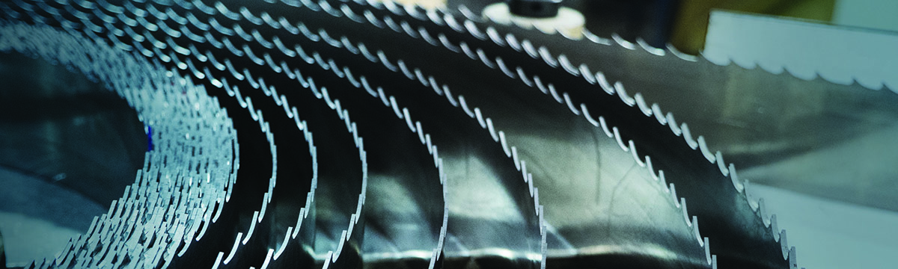

Band Saw Blade Tooth Selection
Notes:
Welcome to band saw tooth selection training from The M. K. Morse Company.
This training modules will last 10-15 minutes and give you all of the information you need to select the right tooth for any application. We will start by explaining why tooth size is so important, and we will end by explaining the steps to select the best tooth size for the job.

Slide 2
Why Is Tooth Size So Critical?
A large tooth can be made to work in a small section.
A small tooth cannot be made to work in a large section.
Notes:
M. K. Morse Band Training Class March, 2013
M. K. Morse Band Training Class October, 2012
Why is tooth size so important? Using the proper size teeth for size of material being cut is the single most important consideration for efficient cutting. You can make a tooth that is too large for a section work properly by adjusting the feed rate of the blade into the work. You cannot, however, make a tooth that is too small for a section work properly.

Slide 3
Notes:
M. K. Morse Band Training Class March, 2013
M. K. Morse Band Training Class October, 2012
Let’s say we want to cut a piece of material this size. By using the proper tooth size as illustrated in the top sketch, the teeth drag across the cut surface, pulling a chip. The gullets do not become completely filled with chip material before the blade leaves the cut.
Now let’s consider the same piece of material and use a tooth that is too small. As the teeth enter the work in the bottom sketch, they begin to fill with chip material. The further the blade travels, the more chip material builds up until the gullets are totally choked and compacted with chips. Now the feed of the blade becomes restricted and the tips cannot properly penetrate the material. The reduced efficiency of the chip creation causes the tips to rub rather than dig into the material. This produces increased frictional heat and the tooth tips begin to dull quickly. Chip material can also work its way out to the sides of the blade causing the blade to bounce in the work resulting in chipped or stripped teeth.
A tooth size that is too small for the section to be cut CANNOT be made to work properly. A tooth that is too large for a section CAN be made to work efficiently by adjusting the feed of the blade so as not to overload the tooth points. Although a tooth that is too large can be made to cut, it is far from optimal. Optimal performance requires the right tooth for the job.

Slide 4
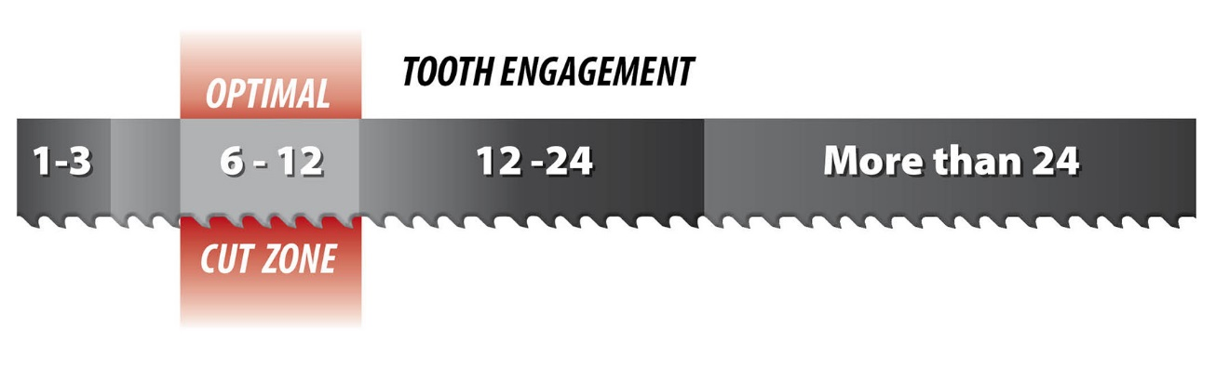
Selecting Tooth Pitch
Bandsaw Tooth Guideline
Notes:
For optimal cutting, there should be 6-12 teeth engaged when the blade is in the cut zone. This provides the largest gullet possible while still having enough teeth engaged to cut efficiently.

Slide 5
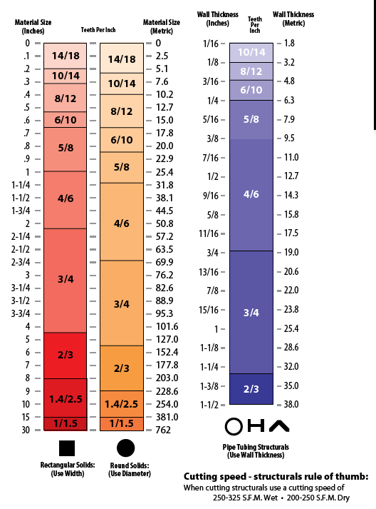
Tooth Guidelines
Bandsaw Blade
Tooth Selection
Minimum and Maximum
Material Sizes
76-99 m/min 60-76 m/min
Notes:
This tooth guideline chart shows the recommended tooth pitch for different sizes of material. Simply find the shape of material at the bottom, and then look to the size in either inches and millimeters to find the correct tooth size.

Slide 6
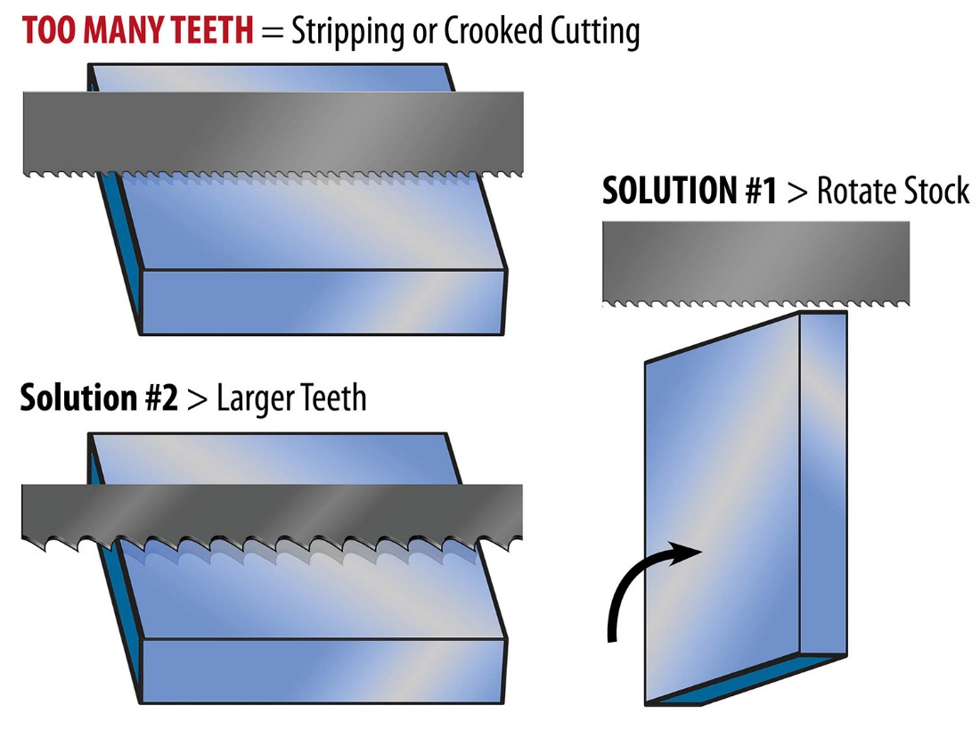
Applying Pitches
Notes:
In many cases, the material can be oriented to take advantage of the blade that is on the saw.

Slide 7
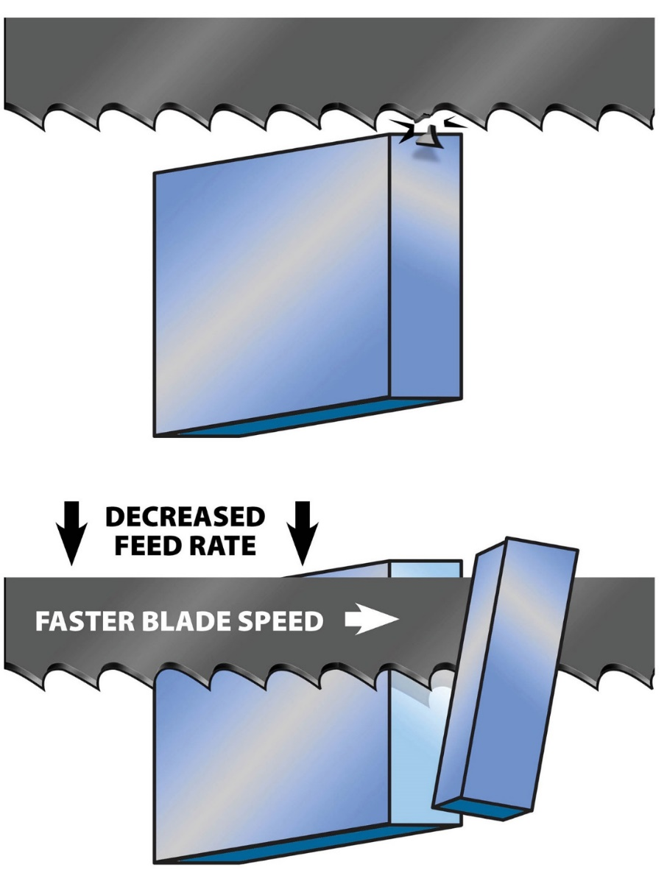
Applying Pitches
Stretching the Rules
Decrease feed rate
Increase blade speed
Notes:
Sometimes we need to make a cut when we don’t have the right blade for the size of workpiece. In cases where the teeth are larger than recommended, slow the feed rate and increase the blade speed. This effectively reduces the amount of amount of material being cut by each tooth, and allows the cut to be made without stripping teeth.

Slide 8
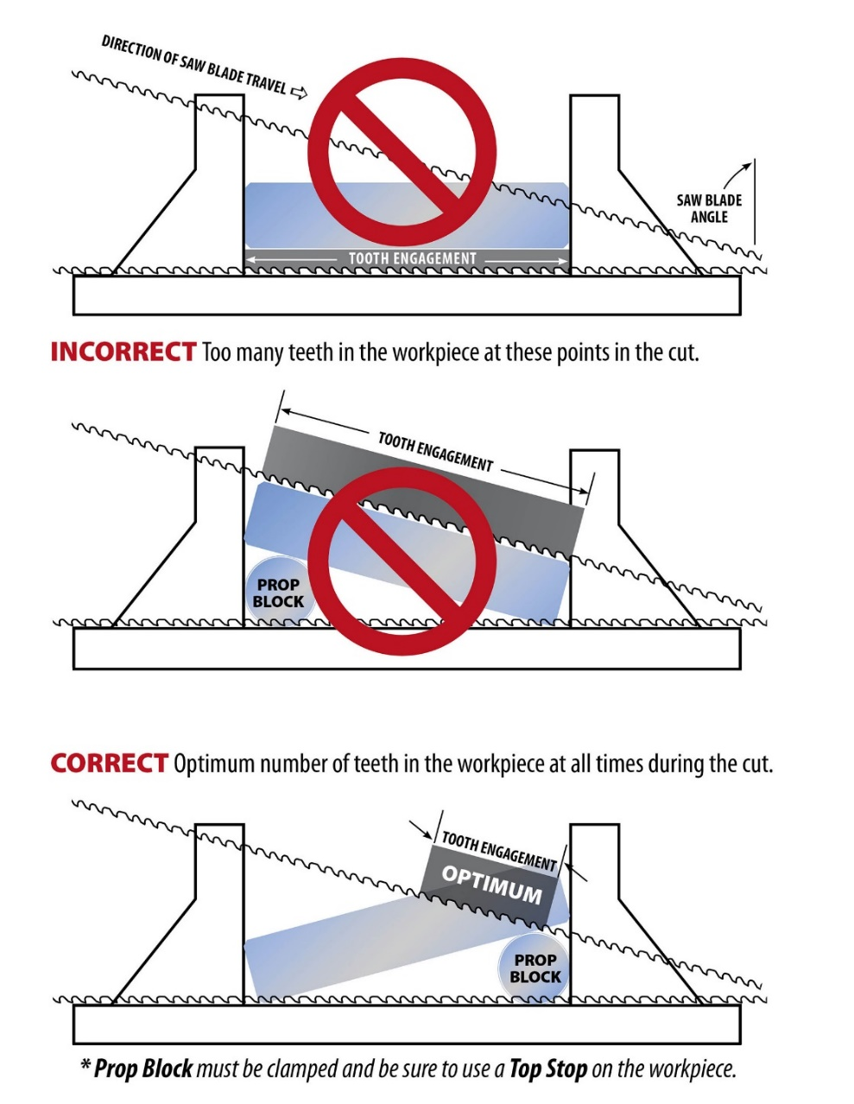
Applying Pitches
Stretching the Rules
Angle material
Cut through thinnest cross-section possible
Notes:
Flat bars can be propped on one side to allow for the blade to cut a smaller cross-section as shown in these illustrations. Just be sure to raise the end of the bar that will allow the blade to have a the smallest possible cross section.

Slide 9
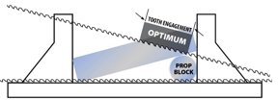
Applying Pitches
Review
Measure your material
Refer to the Tooth Guideline
Chart or calculate dimensions
Adjust material or tooth size for best fit
Tooth Engagement
1 to 3
6 to 12
12 to 24
More than 24
Notes:
To review: Measure your material, refer to the tooth guideline, then adjust material or tooth size for best results.

Slide 10
Sample Application
Example:
What tooth pitch should be used on an Amada HA-400W to cut a 200mm diameter bar of 304 Stainless Steel?
Notes:
Let’s work though an example. What tooth pitch should be used on an Amada HA-400W to cut a 200mm diameter bar of 304 stainless steel?

Slide 11

Shape ?
Notes:
What is the shape?

Slide 12
Shape: Round
Size: ?
Notes:
The shape is round. Next we must find the size. What is the size?

Slide 13
Shape: Round
Size: 200mm
TPI: ?
Notes:
The size is 200mm. This falls between 177.8mm and 203.0mm on the table. So what is the recommended TPI?

Slide 14
Shape: Round
Size: 200mm
TPI: 2/3
Notes:
The recommended TPI is 2/3

Slide 15

Band Saw Blade Tooth Selection
330-453-8187
Notes:
Thank you for your time today. We hope this training improved your knowledge band saw blade tooth selection.
If you have any questions or would like further information, please give us a call at 330-453-8187.

