Slide 1

Notes:
Welcome to Hole Cutting and Boring Tool training from The M. K. Morse Company. This program is designed to arm you with general information about hole boring tools.

Slide 2
Training highlights
The 4 types of hole saws
Hole Cutters
Other boring tools
Notes:
This training session will begin by covering the four types of hole saws and their benefits. It will then move on to hole cutters and other boring tools.

Slide 3
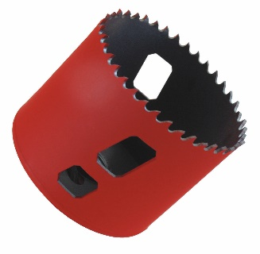
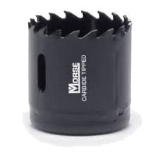
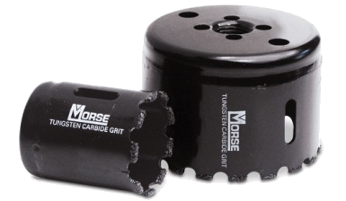
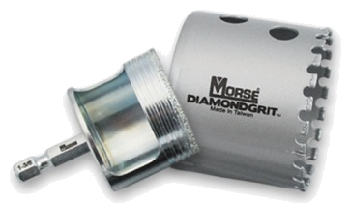
HOLE SAW APPLICATIONS
Plastic
Aluminum
Wood Composite
Stainless Steel
Fiberglass
Plaster/drywall
Acoustical Tile
Cinderblock
Brick
Ceramic Tile
Glass block
Mild Steels
Wood
BI-METAL
CARBIDE TIPPED
CARBIDE & DIAMOND GRIT
Notes:
Bi-metal hole saws are very versatile tools that can cut holes in a variety of materials from woods, to plastics, mild steels and even stainless steel.
Carbide tipped holes saws are well-suited for cutting highly abrasive materials like fiberglass and composites.
Carbide and Diamond Grit edged hole saws are optimized for cutting stone, ceramics and even glass.

Slide 4
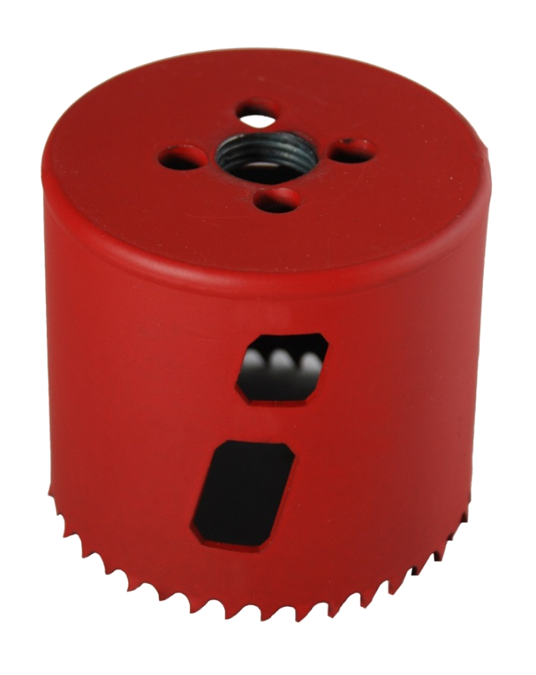
ANATOMY OF A HOLE SAW
ARBOR HOLE - threaded hole where the arbor threads to drive the hole saw
DRIVE PIN HOLES - used with a drive pin arbor, drives hole saw by pins instead of the threads
CAP - welded to the body to form diameter and drive the hole saw
BODY - forms the diameter of the hole saw and controls depth of cut
CUTTING EDGE - dictated by the application, this is the edge that penetrates and bores the hole
KNOCKOUT - in deeper cuts an auxiliary chip reservoir and aids in the removal of the cut slug
Notes:
The majority of hole saws have several features in common.

Slide 5
ANATOMY OF A HOLE SAW
ARBOR HOLE - threaded hole where the arbor threads to drive the hole saw
DRIVE PIN HOLES - used with a drive pin arbor, drives hole saw by pins instead of the threads
CAP - welded to the body to form diameter and drive the hole saw
BODY - forms the diameter of the hole saw and controls depth of cut
CUTTING EDGE - dictated by the application, this is the edge that penetrates and bores the hole
KNOCKOUT - in deeper cuts an auxiliary chip reservoir and aids in the removal of the cut slug
Notes:
The most important feature is the cutting edge. This is the edge that penetrates the workpiece and cuts the hole. Depending on the application, the cutting edge might be made of high speed steel, carbide, carbide grit or diamond grit.

Slide 6
ANATOMY OF A HOLE SAW
ARBOR HOLE - threaded hole where the arbor threads to drive the hole saw
DRIVE PIN HOLES - used with a drive pin arbor, drives hole saw by pins instead of the threads
CAP - welded to the body to form diameter and drive the hole saw
BODY - forms the diameter of the hole saw and controls depth of cut
CUTTING EDGE - dictated by the application, this is the edge that penetrates and bores the hole
KNOCKOUT - in deeper cuts an auxiliary chip reservoir and aids in the removal of the cut slug
Notes:
The body of the hole saw supports the cutting edge. The body must be precisely formed because it supports the precision cutting edge.

Slide 7
ANATOMY OF A HOLE SAW
ARBOR HOLE - threaded hole where the arbor threads to drive the hole saw
DRIVE PIN HOLES - used with a drive pin arbor, drives hole saw by pins instead of the threads
CAP - welded to the body to form diameter and drive the hole saw
BODY - forms the diameter of the hole saw and controls depth of cut
CUTTING EDGE - dictated by the application, this is the edge that penetrates and bores the hole
KNOCKOUT - in deeper cuts an auxiliary chip reservoir and aids in the removal of the cut slug
Notes:
The knockout slots in the body of the hole saw allow the user to remove the slug from the hole saw after the hole is cut. The custom designed slot in the Morse hole saw is especially useful for removing slugs of any thickness.

Slide 8
ANATOMY OF A HOLE SAW
ARBOR HOLE - threaded hole where the arbor threads to drive the hole saw
DRIVE PIN HOLES - used with a drive pin arbor, drives hole saw by pins instead of the threads
CAP - welded to the body to form diameter and drive the hole saw
BODY - forms the diameter of the hole saw and controls depth of cut
CUTTING EDGE - dictated by the application, this is the edge that penetrates and bores the hole
KNOCKOUT - in deeper cuts an auxiliary chip reservoir and aids in the removal of the cut slug
Notes:
The cap of the holesaw is welded to the body and forms the diameter of the hole saw.

Slide 9
ANATOMY OF A HOLE SAW
ARBOR HOLE - threaded hole where the arbor threads to drive the hole saw
DRIVE PIN HOLES - used with a drive pin arbor, drives hole saw by pins instead of the threads
CAP - welded to the body to form diameter and drive the hole saw
BODY - forms the diameter of the hole saw and controls depth of cut
CUTTING EDGE - dictated by the application, this is the edge that penetrates and bores the hole
KNOCKOUT - in deeper cuts an auxiliary chip reservoir and aids in the removal of the cut slug
Notes:
An arbor attaches to the threaded arbor hole in the cap. The drill drives this arbor and the torque of the drill is transmitted to the hole saw though the drive pin holes.

Slide 10
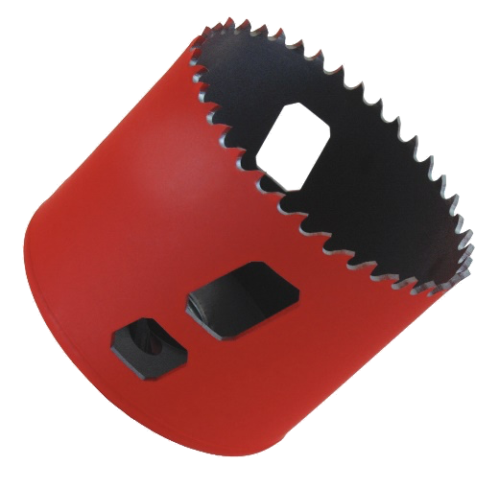
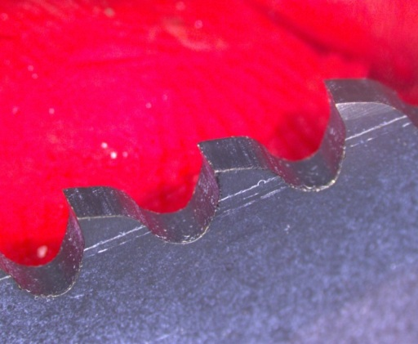
Bi-metal hole saws
Construction: Constructed from composite material that welds a high-speed steel edge wire to a spring-steel backer material. Material is cut to specific lengths and formed to create the diameter. The formed body is combined with the cap of the same diameter and welded together.
High Speed Edge
Weld Zone
Spring Steel Backer
Notes:
Bi-metal hole saws are constructed from composite material consisting of high speed steel and backer steel. The teeth are cut into the high speed steel which is hardened to provide an exceptional combination of toughness and wear resistance.

Slide 11

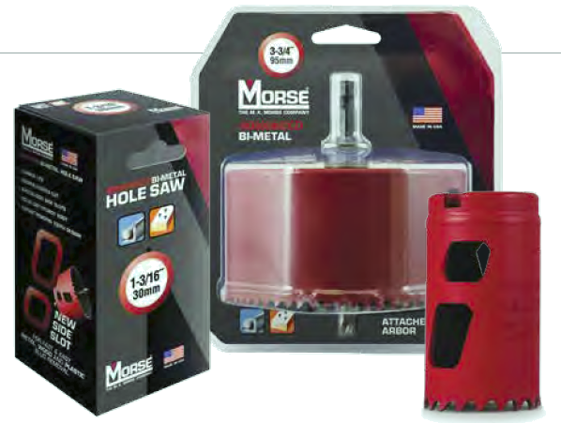
HOLE SAW TYPES
Bi-metal hole saws are extremely versatile. The HSS teeth are resistant to heat and wear, making them the best choice for a wide range of applications. They are the best choice for ferrous and non-ferrous metal applications.
APPLICATIONS
Wood
Plastic
Machinable Metals
Stainless Steel Alloys
Nail-Embedded Wood
Aluminum
Notes:
Bi-metal hole saws are extremely versatile. The high speed steel teeth are resistant to heat and wear, making them the best choice for a wide range of applications including both ferrous and non-ferrous metal applications.

Slide 12
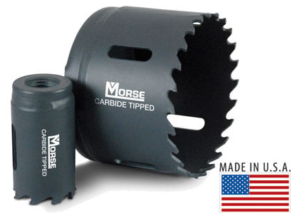
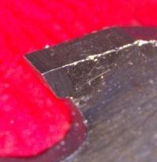
CARBIDE TIPPED HOLE SAWS
Construction: Constructed with a spring-steel backer, instead of a high-speed steel cutting edge, these hole saws have carbide barrels resistance-welded to the tips of each tooth. The tooth form is precision ground into each tip and follows the same forming and welding process to the finished product as bi-metal hole saw.
Carbide Tipped
Spring-Steel Backer
Notes:
Carbide tipped hole saws are also constructed of a steel backer but with carbide tips. Other than tip welding and grinding, the manufacturing process is very similar to that of bi-metal hole saws.

Slide 13
Bi-Metal Hole Saw – Cutting Wood

Slide 14
Bi-Metal Hole Saw – Cutting Metal

Slide 15
CARBIDE HOLE SAWS
Carbide tipped hole saws are wear-resistant and the best choice for cutting softer, highly abrasive materials.
APPLICATIONS
Acoustic Tile
Countertops
Drywall
Fiberboard
Fiberglass
Plaster
Nail-free Wood
Aluminum (not primary)
Stainless Steel (not primary)
Notes:
Carbide tips are extremely hard and wear resistant. This makes these hole saws ideal for cutting fiberglass, and other highly abrasive materials.

Slide 16
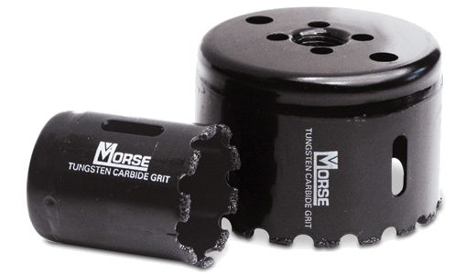
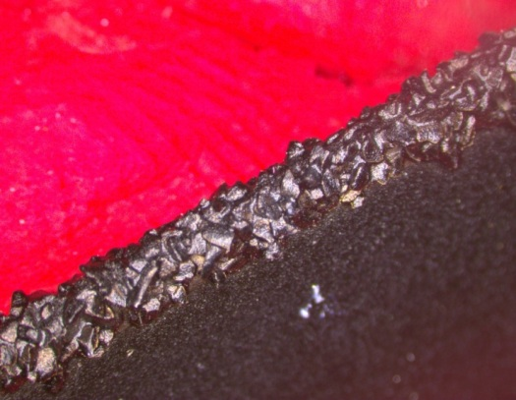
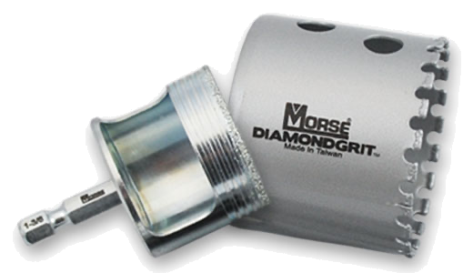
HOLE SAW TYPES
GRIT EDGE - Whether diamond or carbide grit, the cutting edge is heat and/or chemically bonded to a spring-steel backer material. The cutting edge of these hole saws grinds through an application, rather than pulling a chip.
Grit Edge
Notes:
Grit edged hole saws are constructed similarly to bi-metal and carbide tipped hole saws, but the cutting edge is much different. The grit edge consisting of tungsten carbide or diamond grit grinds through the workpiece rather than cutting like a saw tooth.

Slide 17
GRIT EDGE HOLE SAWS
GRIT EDGE hole saws are the best choice for materials too thin, hard or abrasive for bi-metal or carbide-tipped hole saws.
Acoustic Tile
Brick
Cement Board
Ceramics
Composites
Hardyboard
Computer Flooring
Fiberglass
Hardened Steel
Particle Board
Formica
Granite (stone)
Ceramic Tile
Glass Block
Brick (masonry)
Cast Iron
Laminate Flooring
Computer Flooring
Notes:
Tungsten carbide grit hole saws are the best choice for materials that are too thin, too hard, or too abrasive to be cut with bi-metal or carbide tipped hole saws. However, these saws are not for aluminum or stainless steel.
Diamond grit hole saws are great for cutting ceramic tile, granite and other very hard materials.

Slide 18
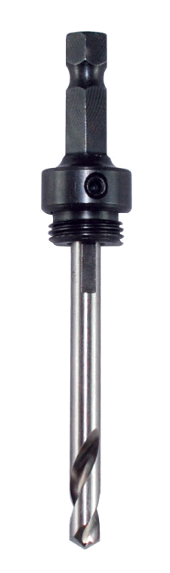
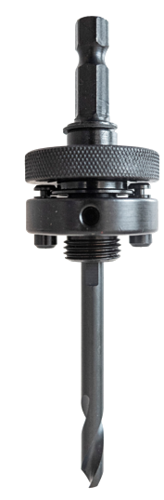
ANATOMY OF AN ARBOR
SHANK - hex size ranges from 1/4" up to 3/8", all 6 sides ground flat for optimal chucking
DRIVE PINS - extended into hole saw cap
THREAD PITCH - either 1/2" - 20 or 5/8" - 18 threads, dependent on the diameter of the hole saw
THREAD
DRIVE
PIN
DRIVE
PILOT DRILL - either high speed steel or carbide tipped, dependent on the application.
Notes:
All of these hole saws would be useless without arbors to drive them.
Key features of an arbor include the shank, drive pins, threads, and pilot drill.

Slide 19
TYPES OF ARBORS
THREAD DRIVE arbors are, as the name indicates, driven by the external threads of the arbor and the internal threads of the hole saw cap.
Typically used for 1-1/4" and smaller diameter hole saws. The diameter of these hole saws is not large enough to utilize the pin drive option. These arbors tend to be manufactured with a 1/2-20 thread designation.
Notes:
Thread drive arbors, as the name indicates, transmit the torque of the drill to the hole saw through a threaded interface with the cap. These arbors are typically used for hole saws that are 1 ¼ inch or smaller.

Slide 20
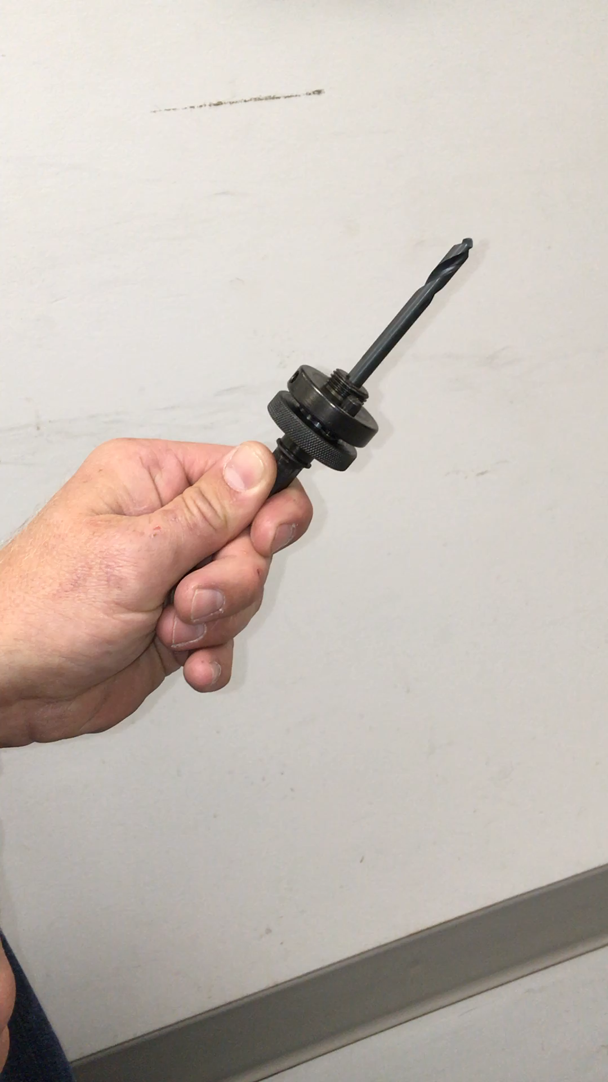
TYPES OF ARBORS
PIN DRIVE arbors are driven by the use of solid steel pins positioned outside the edge of the arbor hole--taking the stress off of the arbor threads.
Typically used for hole saw of 1-3/8" diameter and larger. These arbors are manufactured with a 5/8-18 thread designation.
Notes:
Pin drive arbors utilize drive pins to transmit the torque to the hole saw. These are typically used for hole saws that are 1 3/8 inch or larger diameter.

Slide 21

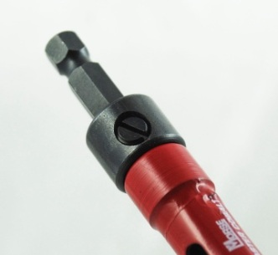
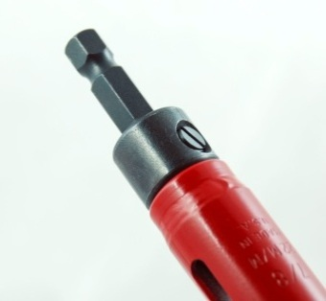
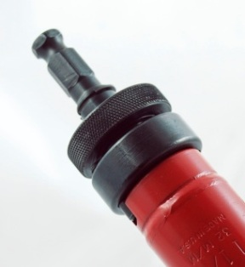
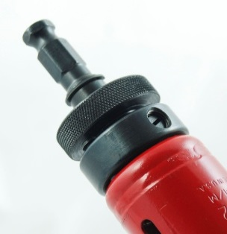
ARBOR ALIGNMENT
ARBOR FOLLOW THROUGH - this is the minimum diameter of hole saw needed for the arbor to pass through the finished cut.
  NO GO - the arbor diameter is greater than the hole being created by the hole saw, creating a overhang and not allowing the arbor to pass through the material as one unit
  GO - the arbor diameter is equal to or less than the diameter of the hole being created by the hole saw, allowing the pass through of the unit
For example: Most smaller, thread drive arbors require a minimum of 3/4" diameter hole for the arbor to be able to pass through the hole made. The larger pin drive arbors require a minimum of a 1-1/2" diameter hole to pass through.
NO GO
GO
NO GO
GO
Notes:
If the hole saw must pass through the hole when cutting, arbor pass through becomes important. Be sure to use an arbor that is not larger than the diameter of the holesaw.

Slide 22
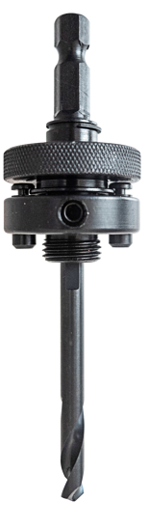
Arbor improvement
LARGER arbor hex-head set-screw
Uses industry standard 1/8 inch hex wrench (or 3mm hex)
Allow for greater torque to be applied to tighten set-screw ensuring stable and consistent placement of the pilot drill and bit
NEW in 2019
Notes:
We recently improved our hole saw arbors to use a larger set screw. This set screw provides better holding power and can be tightened using a standard 1/8 inch hex wrench.

Slide 23
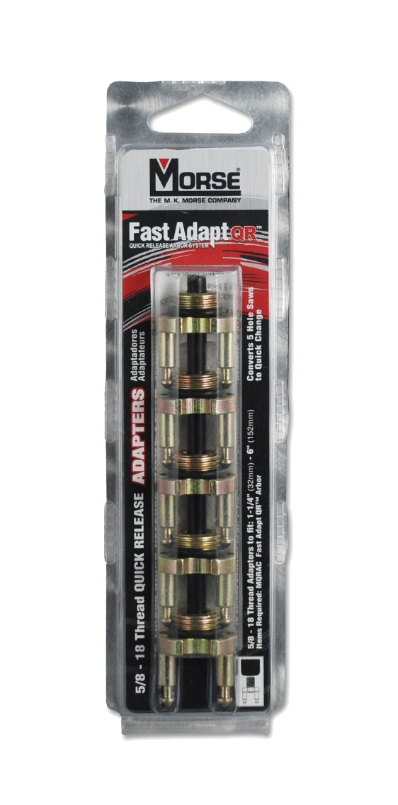
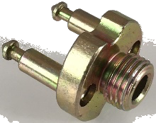
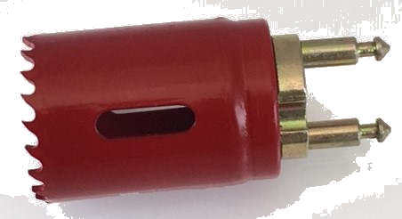
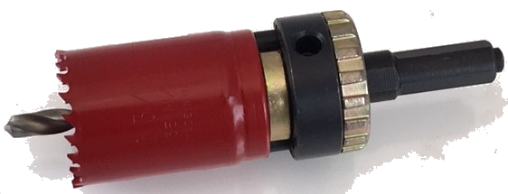
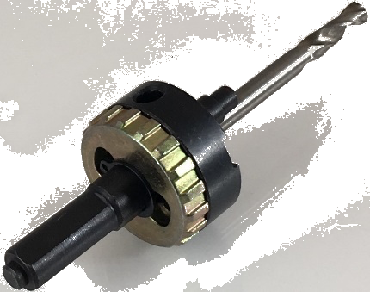
Quick-release Arbor system
For end users that need to frequently change hole saw sizes, a quick-change system is a perfect add-on
Kits contain multiple adapters which stay on the hole saw
  Thread adapter piece to hole saws
  Align arbor pins with notches on adapter
  Insert arbor pins into holes on hole saw cap
  Push adapter pins into arbor to lock in place
  Twist and release to change hole saw
Notes:
We also offer a quick-release arbor system for users that change hole saw sizes frequently. The kit contains adaptors that fit onto multiple hole saws allowing the user to quickly change sizes.

Slide 24
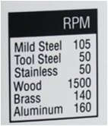
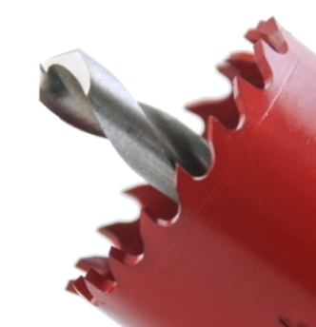

HOLE SAW & ARBOR TECH
Maintain the recommended drill motor speed (rpm's) suggested by the manufacturer for the intended application and hole saw diameter. A good source for this information is the manufacturer's website.
Pilot drill should extend past the cutting edge by a minimum of 1/8". Doing so will allow the pilot drill to guide the hole saw through the cut and minimize the potential for the hole saw to "walk" in the cut.
Lubricate the cut whenever possible. Heat generated by the cut is the #1 enemy of the cutting edge, the cooler the cut is kept, the longer the tool will last.
Don’t over-chuck the arbor by letting the arbor shank bottom-out in the drill chuck.
Notes:
Here are five pro tips that will ensure the hole saws deliver optimal performance.
Follow the recommended speed chart for the material being cut. All workpiece materials have an optimum machining speed. Cutting at that speed will maximize the performance of the tool.
Use lubricants whenever possible. Although these tools can be used dry, lubricants will allow them to cut much faster and last longer.
The pilot drill should extend beyond the cutting edge by at least 1/8 inch.
Remove the hole saw and drill the pilot hole first. This will prevent the teeth from slamming into the workpiece when the pilot drill exits the back side of the material.
Don’t allow the arbor to bottom out in the drill chuck.

Slide 25
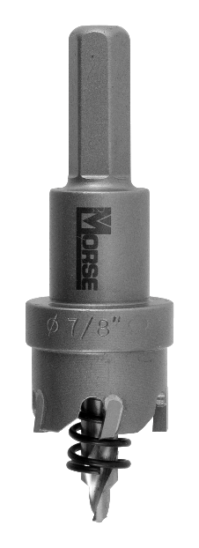
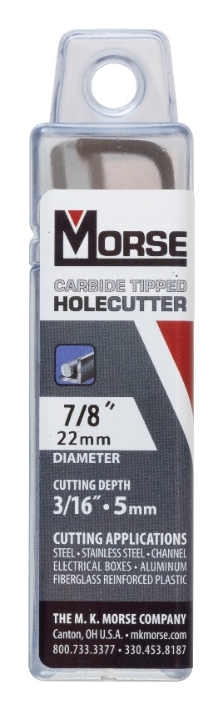
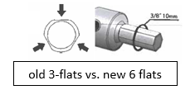
CARBIDE-TIPPED HOLE CUTTERS
Designed for quick, clean, precise cuts in metals and plastics. Available in shallow and deep configurations.
APPLICATIONS
Sheet Metal
Stainless Steel
Pipe
Aluminum
PVC/ABS
Plastic
Notes:
Morse offers a full range of carbide tipped hole cutters that make quick, clean and precise cuts in a wide range of materials. These hole cutters are available in shallow or deep configurations.

Slide 26
Carbide Tipped Hole Cutters

Slide 27
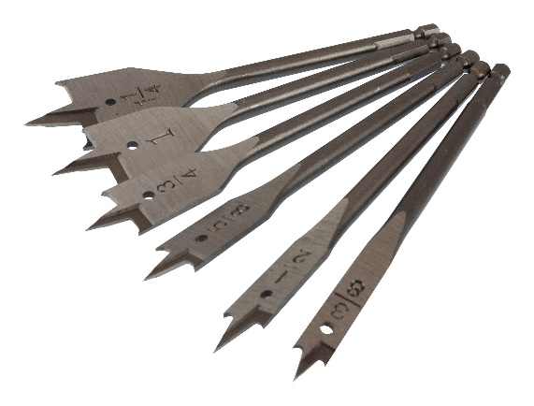
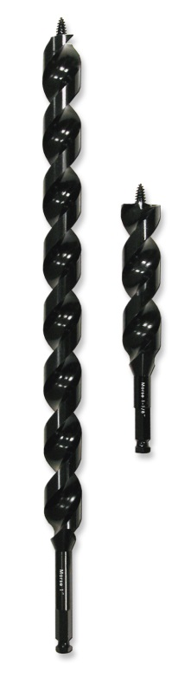
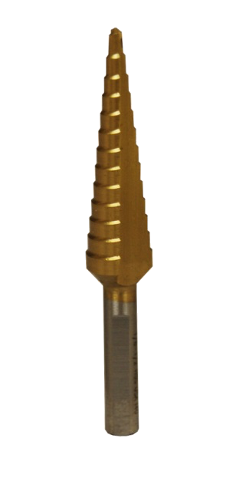
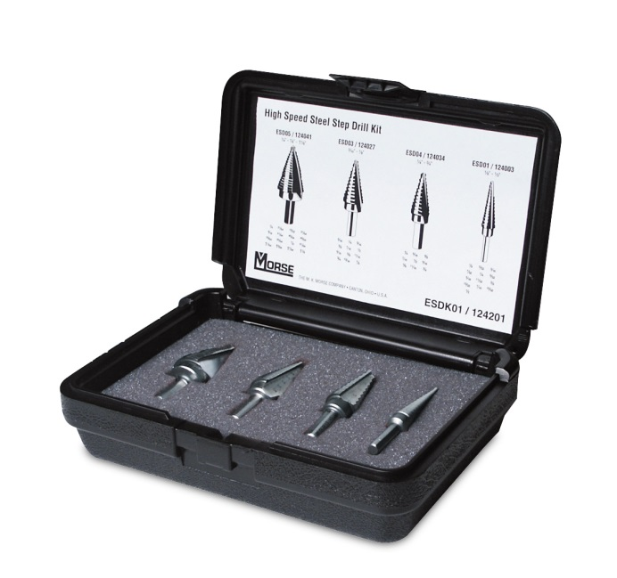
HOLE BORING
Auger Bits
Spade Bits
Step Drills
Notes:
Morse also sells spade bits, auger bits and step drills for other hole boring applications.

Slide 28
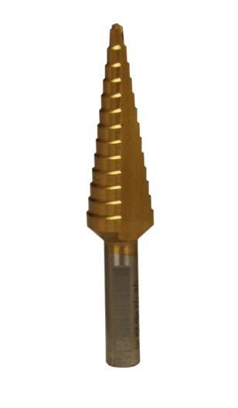

HOLE BORING
Step Drills
Tech Tip:
Use of a step drill is not limited to the sharpness of the leading point. By using a pilot drill first, a step drill can continue to be utilized long after its point has become worn.
The “steps” of a step drill can be resharpened once by any well equipped saw or tool sharpening shop.
  A maximum of .010 to .015 can be removed from the step drill face leaving a slightly smaller hole diameter.
28
Notes:
Step drills are drills with steps of different diameters that are used to drill holes in thin materials. Simply drill until the needed diameter or step is reached.
Two tech tips for step drills are:
Drill a small pilot hole in the workpiece before starting the cut. This will provide better positioning, faster cutting, an prolong the life of the step drill.
The steps can be resharpened once by any well-equipped saw or tool shop.

Slide 29

Hole Cutting and Boring Tools
330-453-8187
Notes:
Thank you for your time today. We hope this training improved your knowledge of hole cutting and boring tools.
If you have any questions or would like further information, please give us a call at 330-453-8187.

